Slide 1
Operating Systems
Dr. Deepak Dembla

Slide 2
Process Scheduling

Slide 3
Objectives
After reading this chapter, you should be able to understand:
CPU-bound and I/O-bound processes
When to schedule a process
Long-term scheduling
Medium-term scheduling
Short-term scheduling
Non-preemptive scheduling
Preemptive scheduling
Scheduling goals
Scheduling algorithms
Multilevel Scheduling algorithms
Fair-share scheduling
Lottery scheduling

Slide 4
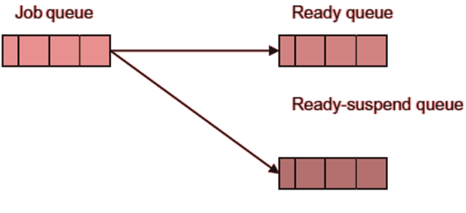
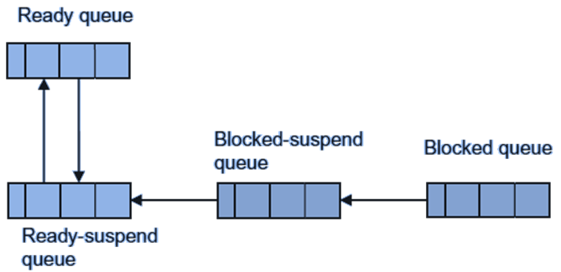
Scheduling levels
Long-term Scheduling
Degree of multiprogramming
The long-term scheduler is also called when the CPU is idle more than a threshold time.
Medium-term Scheduling
Whenever the suspended process is swapped out in the disk, there are two choices for bringing in a process which is ready for execution. First is a suspended process from the suspend queue whose waiting event is over now Second, a new process from the job queue

Slide 5
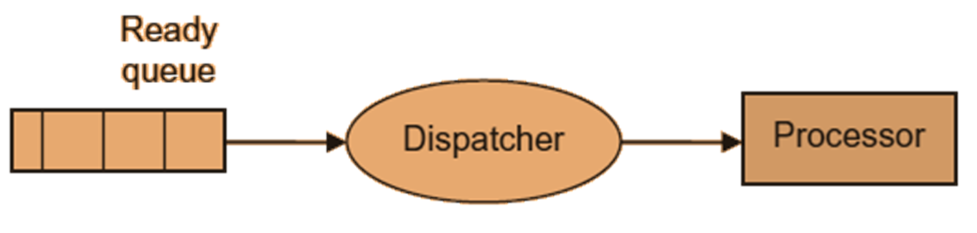
Scheduling levels
Short-term Scheduling

Slide 6
Scheduling types
Non-preemptive scheduling
Preemptive scheduling
The preemption can be in the following situations:
When a new process with higher priority as compared to the running process arrives in the ready queue
When a resource or I/O release interrupt occurs and due to this a blocked process arrives in the ready queue
A timer interrupt occurs.

Slide 7
Process scheduling goals
Turnaround Time
time elapsed between submission of a job and its termination
tr = wt + x
where tr is turnaround time of a process,
wt is waiting time of the process in the ready queue
x is the total service or execution time of the process
W_{tr}= tr/x
where W_{tr} is weighted or normalized turnaround time.
W_{tr} is the indication of the service what a process is getting.

Slide 8
Process scheduling goals
The minimum possible value of W_{tr} is 1 which means that the process does not wait and gets the execution immediately. The increasing values indicate the delay in getting the processor or the poorer service the process gets.
Waiting Time
Response time
Time period between the time of submission of a process and the first response given by the process to the user

Slide 9
Process scheduling goals
Balance
At a particular instant of time, all resources should be used in balance. For this purpose, a good mix of CPU bound and I/O bound processes will help.
Predictability
Deadlines

Slide 10
Scheduling algorithms
First come first served (FCFS)
Priority Scheduling
Priority-Number based Scheduling
Shortest process next (SPN)
non-preemptive scheduling algorithm
Shortest Remaining Time Next (SRN)
Preemptive version of SPN
Practically not possible
Estimate the execution time for a process from its past history of execution.
Thus, this scheduling algorithm can be used if we have past data of execution time of the processes so that the next CPU burst of a process can be estimated.

Slide 11
Shortest Remaining Time Next (SRN)
If recent observed burst time for a process is t₀, then its next estimated burst value will be αt₀+(1-α)t₁ where α is the weighting factor and t₁ is older burst value of the process.
S_{n+1} = αt_{n} + (1-α) αt_{n-1} + ….
Based on the past values on time series, formula for predicting the next CPU burst value of process may be given as:
S_{n+1} = αt_{n} + (1-α)S_{n}
where S_{n+1} is predicted next value for CPU burst
t_{n} is value of nth CPU burst, i.e. recent information
S_{n} is the past history information
α is the constant weighting factor and 0<=α<=1

Slide 12
Shortest Remaining Time Next (SRN)
In this equation through the choice of α, we can choose to quickly forget the past data or retain it for a longer time. For example if α=0, then
S_{n+1} = S_{n}
It means the recent information has no effect and we are considering the past data.
Similarly if α=1, then
S_{n+1} = t_{n}
It means, only recent information is relevant and past data is ignored.
To have a balance between the past data and recent data, we choose α=1/2.

Slide 13
Scheduling algorithms
Round Robin Scheduling
Rule 1: 80% of the CPU bursts should be smaller than the time quantum.
Rule 2: Context switch time is a small fraction of time quantum nearly 10 %.
If there are n number of processes in a system and t is the time quantum, what is the maximum time a process need to wait for its execution?
Improved Round robin Scheduling
In RR waiting time of processes and thereby average waiting time of the system increases.

Slide 14
Scheduling algorithms
CPU consumption ratio = Actual CPU time consumed/total estimated execution time
This ratio will provide us the scenario which long processes need attention, i.e. their waiting time should be reduced.
So the process which has minimum CPU consumption ratio will be selected next for the scheduling.
But what about the short processes?
Schedule a process if its CPU consumption ratio is greater than 0.60 else schedule a process whose CPU consumption ratio is minimum.

Slide 15
Scheduling algorithms
Highest Response Ratio Next scheduling (HRRN)Response ratio = Time elapsed in the system / CPU time consumed by the process
Schedule a process which has highest response ratio.
Virtual Round Robin Scheduling
Starvation of I/O-bound processes over processor-bound processes in RR
Two queues: ready queue and auxiliary queue for I/O bound processes.
Auxiliary queue has been introduced so that I/O-bound processes after completing their I/O need not to compete with other processes and will get preference over other processes

Slide 16
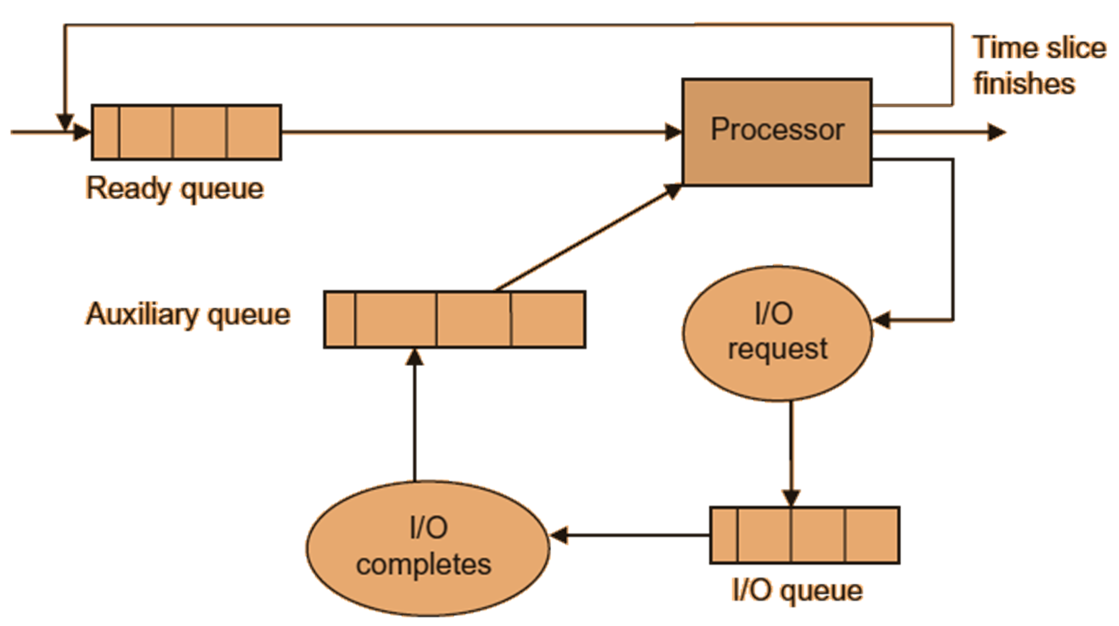
Virtual round robin scheduling

Slide 17
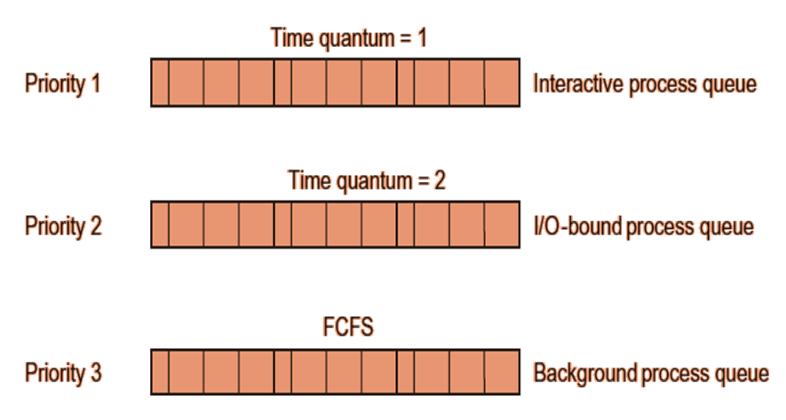
Multi-level queue scheduling
Multilevel Queue Scheduling
Interactive processes
Non-interactive processes
Processor-bound processes
I/O-bound processes
Foreground processes
Background processes

Slide 18
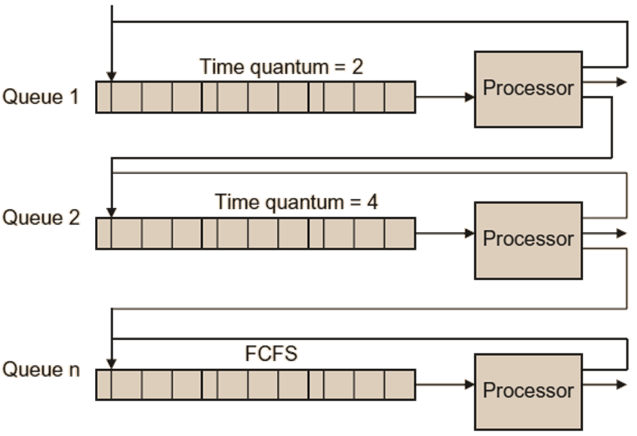
Multilevel feedback/adaptive queue scheduling
Multilevel Feedback/Adaptive Queue Scheduling
Getting the feedback about the behavior of a process and deciding its category which was not possible before its execution.
In this way, every process first enters the highest priority queue, starts executing and consumes its time quantum.
Based on its execution requirement it is then categorized in the queues.

Slide 19
Fair-Share Scheduling
Fair-Share Scheduling
There may be one user with many processes or multiple groups and each group may be composed of multiple users.
For example, there are two groups of users accessing the system. One group is responsible for accessing the general information only which needs very short time. On the other hand, there is a group who is responsible for accessing some critical data and performing some decisions.

